Slide 1
Reasonable Accommodations in the Workplace
Erissa Duvall - https://linktr.ee/corgidev

Slide 2
Warning
I may allude to some topics of discrimination, bullying, domestic violence, child abuse, and trauma.
However, I will do my best to keep these to a minimum and/or vague to avoid causing anyone any distress.

Slide 3
Disclaimer
While I may mention some examples from current/past jobs, I am not speaking for my employers.
Additionally, I am not a lawyer and nothing I say should be taken as definitive legal advice.

Slide 4
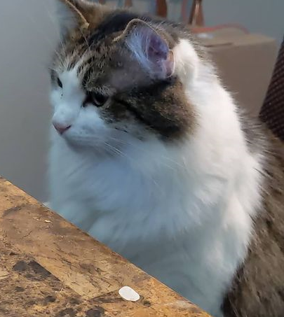
Overview
What is disability?
Types of Accommodations
My Persona
Possible Rejection Reasons
Tips for RA Requestors
Tips for RA Professionals
Benefits of an Inclusive RA Policy & Accessible Workplace
Resources
QA
Notes:
Image source: Erissa Duvall’s cat Nibbler

Slide 5
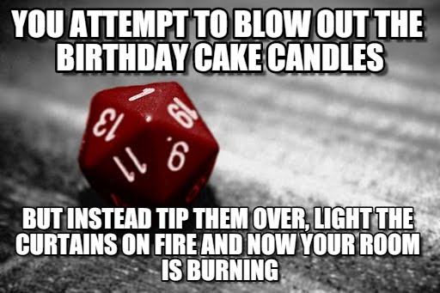
What is a disability?
Definitions
ADA
Social Model
Disabilities can affect people in different ways:
What part of their life does it affect?
Ability to eat
Ability to breathe
Ability to walk, stand, or lift
Ability to interpret information
Ability to see or hear
Ability to care for themselves
Visibility of the disability
When does it affect them? (temporary, permanent, situational)
Notes:
Image sourced from Critical Successes and Critical Failures from 1 to 20 in D&D – Nerdarchy
Image Source URL: https://nerdarchy.com/critical-successes-and-critical-failures-from-1-to-20-in-dd/
ADA notes from ADA.gov:
The ADA prohibits discrimination on the basis of disability in employment, State and local government, public accommodations, commercial facilities, transportation, and telecommunications. It also applies to the United States Congress.
To be protected by the ADA, one must have a disability or have a relationship or association with an individual with a disability. An individual with a disability is defined by the ADA as a person who has a physical or mental impairment that substantially limits one or more major life activities, a person who has a history or record of such an impairment, or a person who is perceived by others as having such an impairment. The ADA does not specifically name all of the impairments that are covered.
ADA is divided up into multiple sections aka Title:
Employment
State & Local Gov Activities
Public Transit
Public Accommodations
Telecommunications Relay Services
There are also other pieces of Disability Rights legislation that you can learn more about at the following ADA.gov URL: https://www.ada.gov/resources/disability-rights-guide/
Some of these pieces of legislation include:
Telecommunications Act
Fair Housing Act
Air Carrier Access Act
Voting Accessibility for the Elderly & Handicapped Act
National Voter Registration Act
Civil Rights of Institutionalized Persons Act
Individuals with Disabilities Education Act
Rehabilitation Act of 1973
General Sources of Disability Rights Information

Slide 6
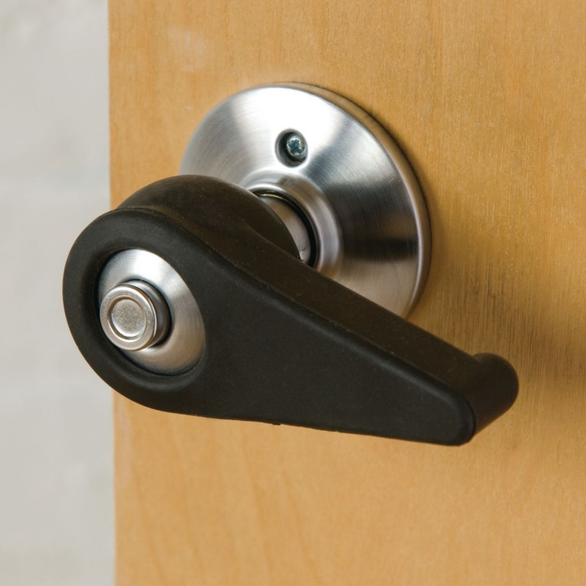
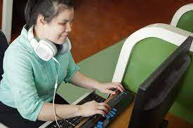
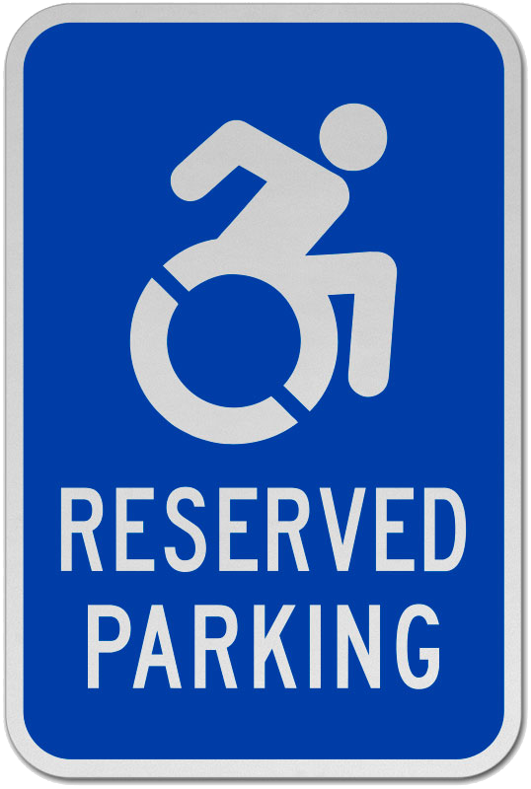
Types of Reasonable Accommodation
Types
Non-Tech
Low-Tech
High-Tech
Accommodations can involve:
Job restructuring
Flexible/Modified work schedules
Modified equipment purchase
Training
Modified policies
Light duty
Leave of Absence
Notes:
Information sourced from the Washington DC Office of Disability Rights:
Types of Reasonable Accommodation | odr (dc.gov) - https://odr.dc.gov/book/manual-accommodating-employees-disabilities/types-reasonable-accommodation
When Can the District Deny an Accommodation? | odr (dc.gov) - https://odr.dc.gov/book/manual-accommodating-employees-disabilities/when-can-district-deny-accommodation
Job Accommodation Network (JAN) Article: Employers' Practical Guide to Reasonable Accommodation Under the Americans with Disabilities Act (ADA) - https://askjan.org/publications/employers/employers-guide.cfm
Type definitions listed on the DC site:
No-tech: An accommodation costs little or no money…just time, support and creativity (e.g., additional preparation time for an individual, or a color-coded filing system).
Low-tech: Any accommodation that is technologically simple or unsophisticated, and readily available in most offices (e.g., replacing a doorknob with an accessible door handle, providing a magnifier).
High-tech: Any accommodation that uses advanced or sophisticated devices (e.g., screen reading software with synthesized speech).
Doorknob image sourced from Lauren Brinson’s Oregon State blog, but she included that it is an image of Sammons Preston Rubber Doorknob Extension, an adapter for round doorknobs. The blog url is: https://blogs.oregonstate.edu/laurelbrinsondesign/2021/02/28/accessible-doorknobs-are-the-hill-im-choosing-to-die-on/
Image of a female screen reader user from TPGi. TPGi url is https://www.tpgi.com/what-is-a-screen-reader-and-why-are-they-important/.
Accessible parking sign image sourced from SafetySign.com. Site URL is https://www.safetysign.com/products/8807/accessible-reserved-parking-sign

Slide 7
Important Note
Just because 2 people have the same disability label; DOES NOT mean they will present in the same way or encounter the same barriers.

Slide 8
Do I “look” like I have a disability?

Slide 9

My Persona
Erissa is a 38-year-old Accessibility Specialist who is good with technology, organized, and detail oriented.
Her conditions include anxiety, ADHD, auditory processing disorder, frontal lobe & executive function disorder, and a spinal birth defect.
Frustrations
Intermittent difficulties with hearing
Struggles with face-to-face communication
Easily distracted
Limited working memory
Difficulty context switching
Occasionally overwhelmed
Difficulty standing and carrying things for extended periods of time.
Difficulty going up and down stairs.
Notes:
Based the formatting of my Persona is based off the format used by the UK Central Digital & Data Office.
You can view an example persona at the following URL: Pawel: user with Asperger's - GOV.UK (www.gov.uk) - https://www.gov.uk/government/publications/understanding-disabilities-and-impairments-user-profiles/pawel-user-with-aspergers

Slide 10
My Persona (Continued)
I benefit from:
Captioning in meetings
Alternate work location
Flexible deadlines for work
Clearly defined tasks / scope
Training opportunities
Documented processes
Limited context switching
Minimal interruptions
Flexible breaks when overwhelmed
Alternative start / stop times
A padded, ergonomic desk chair
The ability to sit when needed

Slide 11

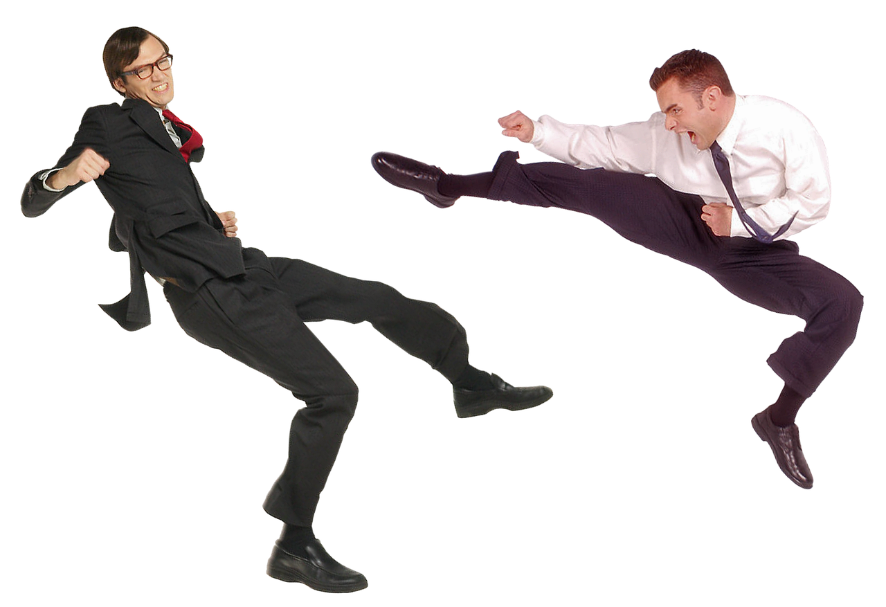
Possible Rejection Reasons
Undue Hardship
Direct Threat
Notes:
Information sourced from the Washington DC Office of Disability Rights:
Types of Reasonable Accommodation | odr (dc.gov) - https://odr.dc.gov/book/manual-accommodating-employees-disabilities/types-reasonable-accommodation
When Can the District Deny an Accommodation? | odr (dc.gov) - https://odr.dc.gov/book/manual-accommodating-employees-disabilities/when-can-district-deny-accommodation
Some details on what defines something as an undue hardship and direct threat were sourced from the following sites:
The Direct Threat Defense Under the ADA | Nolo - https://www.nolo.com/legal-encyclopedia/the-direct-threat-defense-under-the-ada.html
What Does “Direct Threat” Mean – A Deconstructive Series for ADA Terminology (askjan.org) - https://askjan.org/articles/What-Does-Direct-Threat-Mean-A-Deconstructive-Series-for-ADA-Terminology.cfm
[Undue Hardship]
An employer does not have to provide a reasonable accommodation that would cause an "undue hardship" to the employer. Generalized conclusions will not suffice to support a claim of undue hardship. Instead, undue hardship must be based on an individualized assessment of current circumstances that show that a specific reasonable accommodation would cause significant difficulty or expense. A determination of undue hardship should be based on several factors, including:
the nature and cost of the accommodation needed;
the overall financial resources of the facility making the reasonable accommodation; the number of persons employed at this facility; the effect on expenses and resources of the facility;
the overall financial resources, size, number of employees, and type and location of facilities of the employer (if the facility involved in the reasonable accommodation is part of a larger entity);
the type of operation of the employer, including the structure and functions of the workforce, the geographic separateness, and the administrative or fiscal relationship of the facility involved in making the accommodation to the employer;
the impact of the accommodation on the operation of the facility.
[Direct Threat] (Applies to hiring and firing an employee who is posing a direct threat.)
The employer must be prepared to show that there is:
significant risk of substantial harm;
the specific risk must be identified;
it must be a current risk, not one that is speculative or remote;
the assessment of risk must be based on objective medical or other factual evidence regarding a particular individual; and
even if a genuine significant risk of substantial harm exists, the employer must consider whether the risk can be eliminated or reduced below the level of a "direct threat" by reasonable accommodation.
Enforcement Guidance on Reasonable Accommodation and Undue Hardship under the ADA | U.S. Equal Employment Opportunity Commission (eeoc.gov) - https://www.eeoc.gov/laws/guidance/enforcement-guidance-reasonable-accommodation-and-undue-hardship-under-ada
What does "Undue Hardship" mean? - A Deconstructive Series for ADA Terminology (askjan.org) - https://askjan.org/articles/Undue-Hardship-is-a-Process.cfm
Image Sources:
Image of 2 office workers fighting sourced from Pixabay: Fight Conflict Argument - Free photo on Pixabay – Pixabay - https://pixabay.com/photos/fight-conflict-argument-showdown-2954705/
Image of office worker carrying a boulder sourced from Businessmen with laptop and stone Stock Photo | Adobe Stock - https://stock.adobe.com/images/businessmen-with-laptop-and-stone/133406502?asset_id=133406502

Slide 12
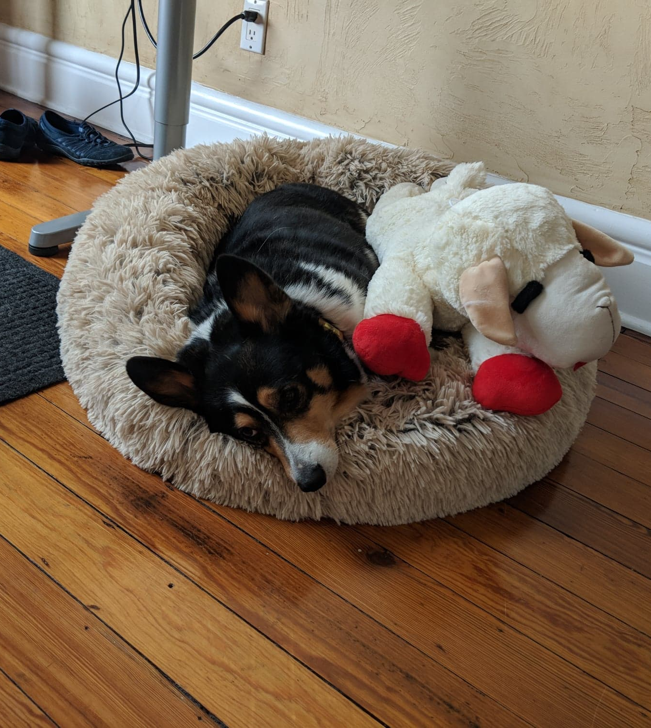
Benefits of an Inclusive / Accessible Workplace
Positive image
Builds a welcoming environment
Attract more customers, applicants, etc.
Improves retention
This in turn encourages:
Productivity
Diversity
Innovation

Slide 13
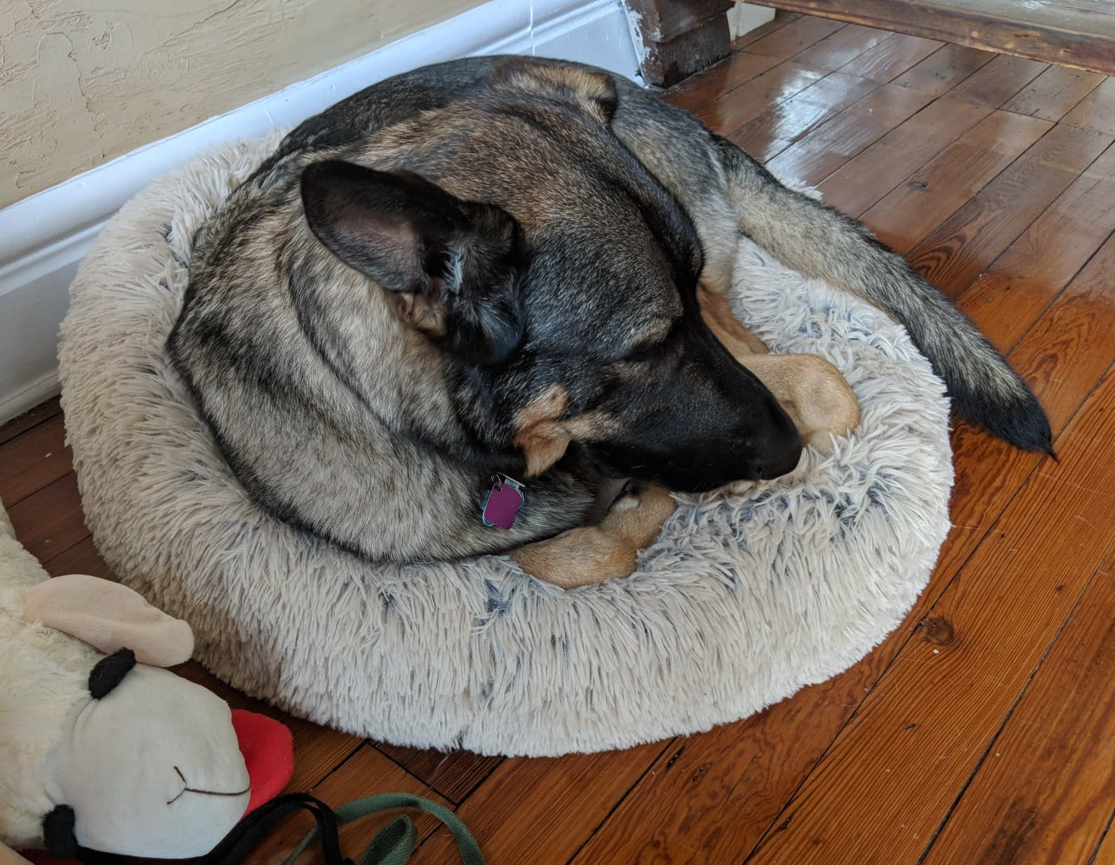
Tips for RA Requestors
Find a primary physician and build a rapport with them.
If you can, try to get a formal diagnosis and/or accommodation note from a physician.
Identify a variety of options.
Be open to compromise.
Identify if your company has a formal procedure.
Remember that not all companies are required to follow ADA regulations, even if they really should.
Notes:
Finding a primary physician
- May be able to go ahead and write an accommodation note for some basic accommodations to add some validity to your claim in the eyes of whomever is going to have to approve it.
- Could give you breathing room until you can meet a specialist
- Might be able to help you better identify the right doctor you need to see for an accommodation.

Slide 14
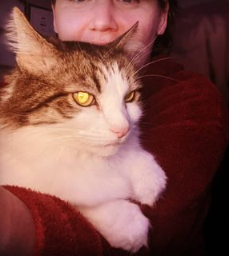
Tips for RA Professionals
Accessibility throughout
Accessibility procurement policies
Source feedback from applicants, recruiters, and current employees.
Think social model
Require minimal information from the requestor
Minimize access to requestor information
Develop Accessibility personas
Learn assistive technology basics
Involve IT and facilities management departments
Have a clearly documented process that includes employees, contractors, applicants, and interviewees.
Make sure the documentation and overall process is accessible to all the aforementioned individuals.
Notes:
Social Model Definition of Disability:
Developed by disability rights activities in the 1970s and 80s.
“…views the origins of disability as the mental attitudes and physical structures of society, rather than a medical condition faced by an individual.” – Social Creatures
Source URL: https://www.thesocialcreatures.org/thecreaturetimes/the-social-model-of-disability
The social model essentially says that it is society and the environment in which a person is in that creates barriers for someone when living their daily life more so than a medical condition.
There can be many barriers to anything medical related can involve:
Cost
Unconscious, and often deeply ingrained, bias
Some procedures are not as well covered, if at all, by insurance regardless of how good the insurance is.
Minimize how much info is provided to involved parties:
Minimizes unconscious bias that may slip in when people know who specifically a user is.
Lessens risk of a HIPPA violation or leaking private information a person may not want everyone knowing.
Example) The RA department has an employee named is John Doe, he is 32, works as a lead developer, and has vision loss due to a traumatic injury.
Since sight loss tends to be a more apparent disability, they may require no medical documentation. However, they may need such details for, for leave or insurance reasons.
When RA coordinates with IT to find a solution to help John, they would provide the absolute minimum details necessary for IT to identify a solution.
So they may just tell them that they have a developer, who is having trouble using his computer due to sight loss.
They might go into more details on exact job duties, applications used, hardware used. Especially since this could help them ID if they already have a solution available.
If the user needs to be added to a security group they would then need to share the users ID and/or name. However, beyond that, they would avoid sharing any personal details about the user.

Slide 15
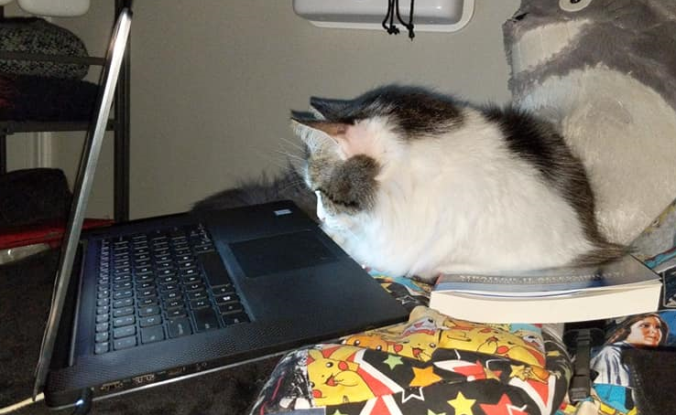
RA Resources
Government RA Documentation
Types of Reasonable Accommodation | Office of Disability Rights (ODR)
When Can the District Deny an Accommodation? | Office of Disability Rights (ODR)
Enforcement Guidance on Reasonable Accommodation and Undue Hardship under the ADA | U.S. Equal Employment Opportunity Commission (EEOC)
Accommodations | U.S. Department of Labor (DOL)
The Americans with Disabilities Act | ADA

Slide 16
RA Resources (Continued)
Accessibility Personas
Creating accessibility personas. | by Alicia Crowther | UX Collective
Personas with Disabilities. Some people love personas. Some people… | by Sheri Byrne-Haber, CPACC | The Startup | Medium
Accessibility Personas | UK Government Digital Service GitHub
Design Personas: Digital Accessibility Recommendations for Interactive Designs | Office of Digital Accessibility | Stanford University
Tips for Creating Accessibility Personas | Bureau of Internet Accessibility

Slide 17
RA Resources Continued
Additional RA Documentation
Employers' Practical Guide to Reasonable Accommodation Under the Americans with Disabilities Act (ADA) - Job Accommodation Network (JAN)
Accommodations and Accessibility | American Foundation for the Blind
What is ADA Compliance | ADA Compliant Business - Advocates for the Life Skills & Opportunity (ALSO)
Americans With Disabilities Act (ADA) Myths And Facts - Paralyzed Veterans of America (PVA)

Slide 18

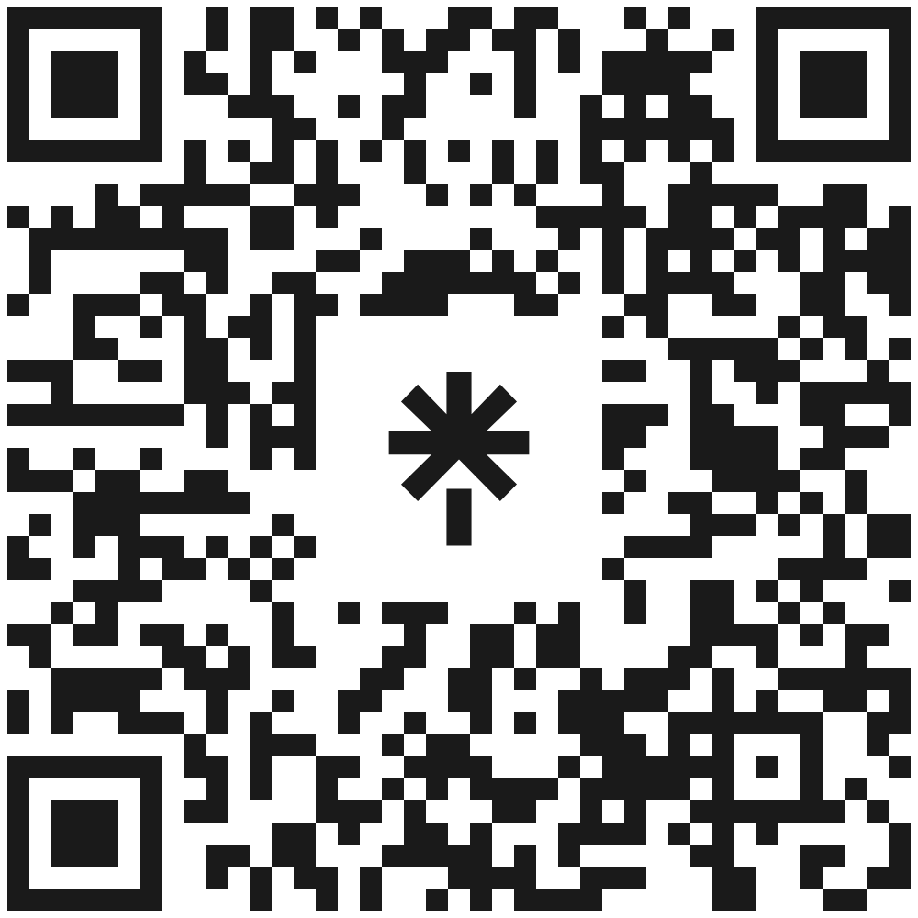
Thank You! Questions & Answers
https://linktr.ee/corgidev

